Slide 1
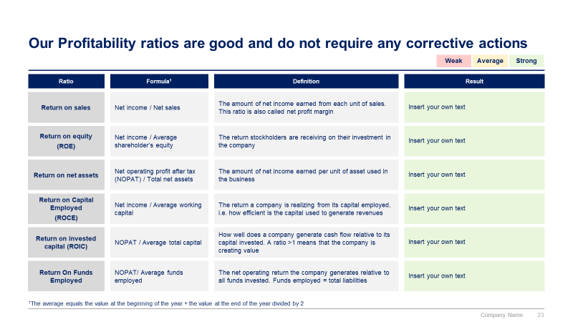
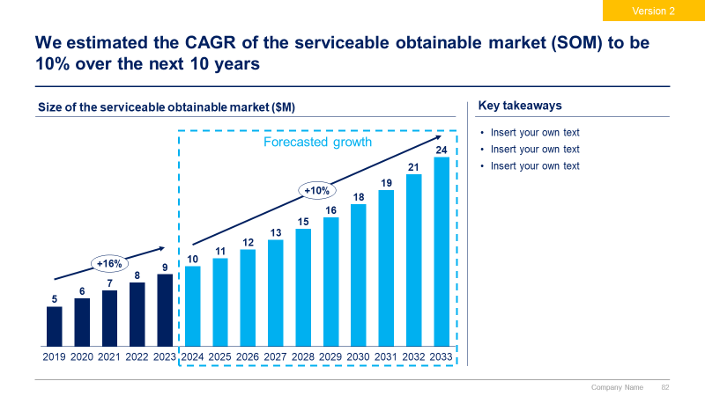
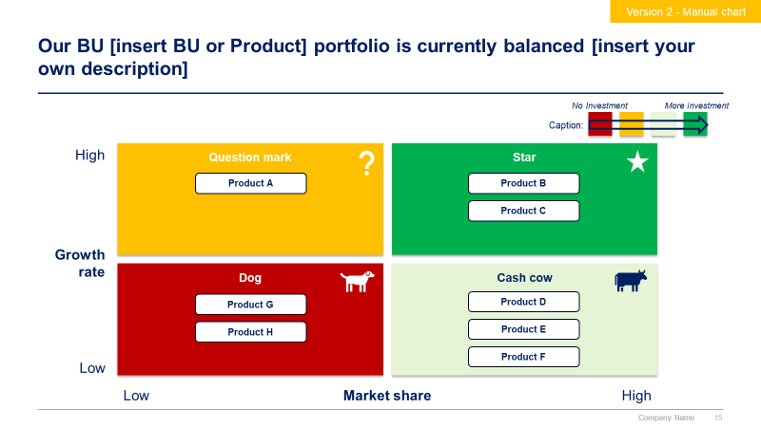
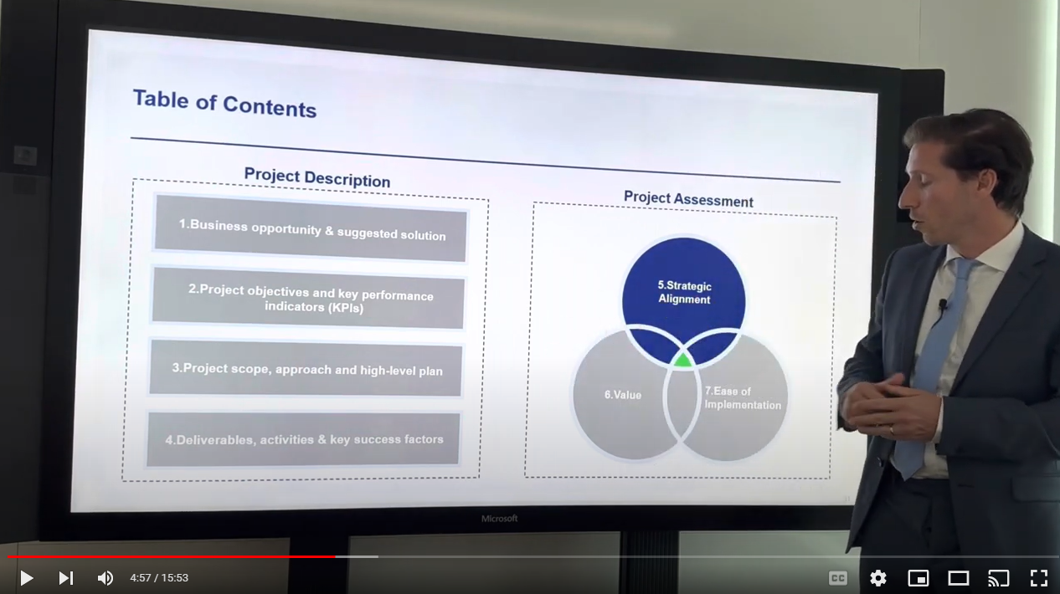
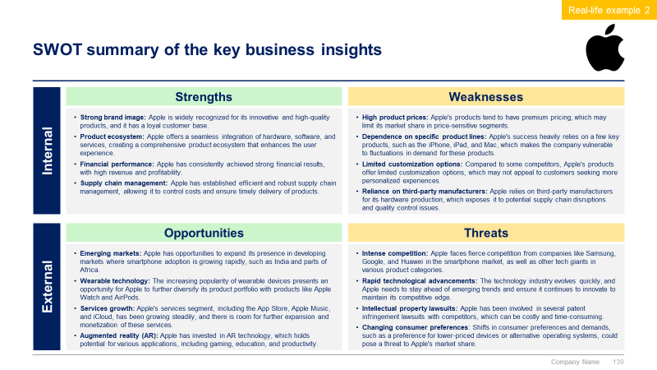
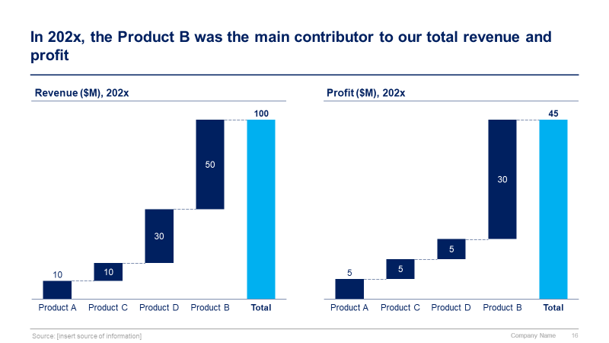
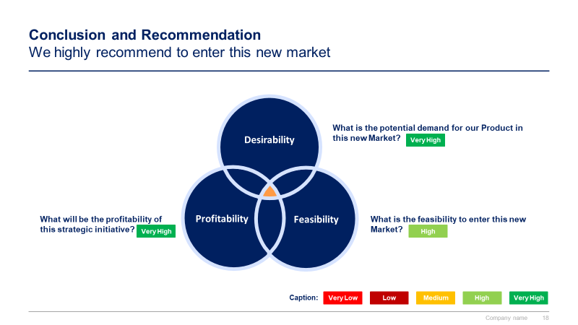
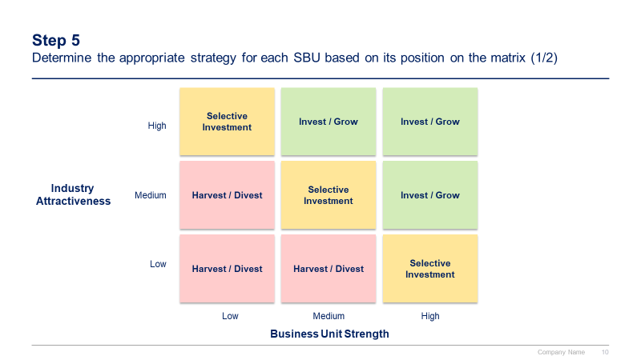
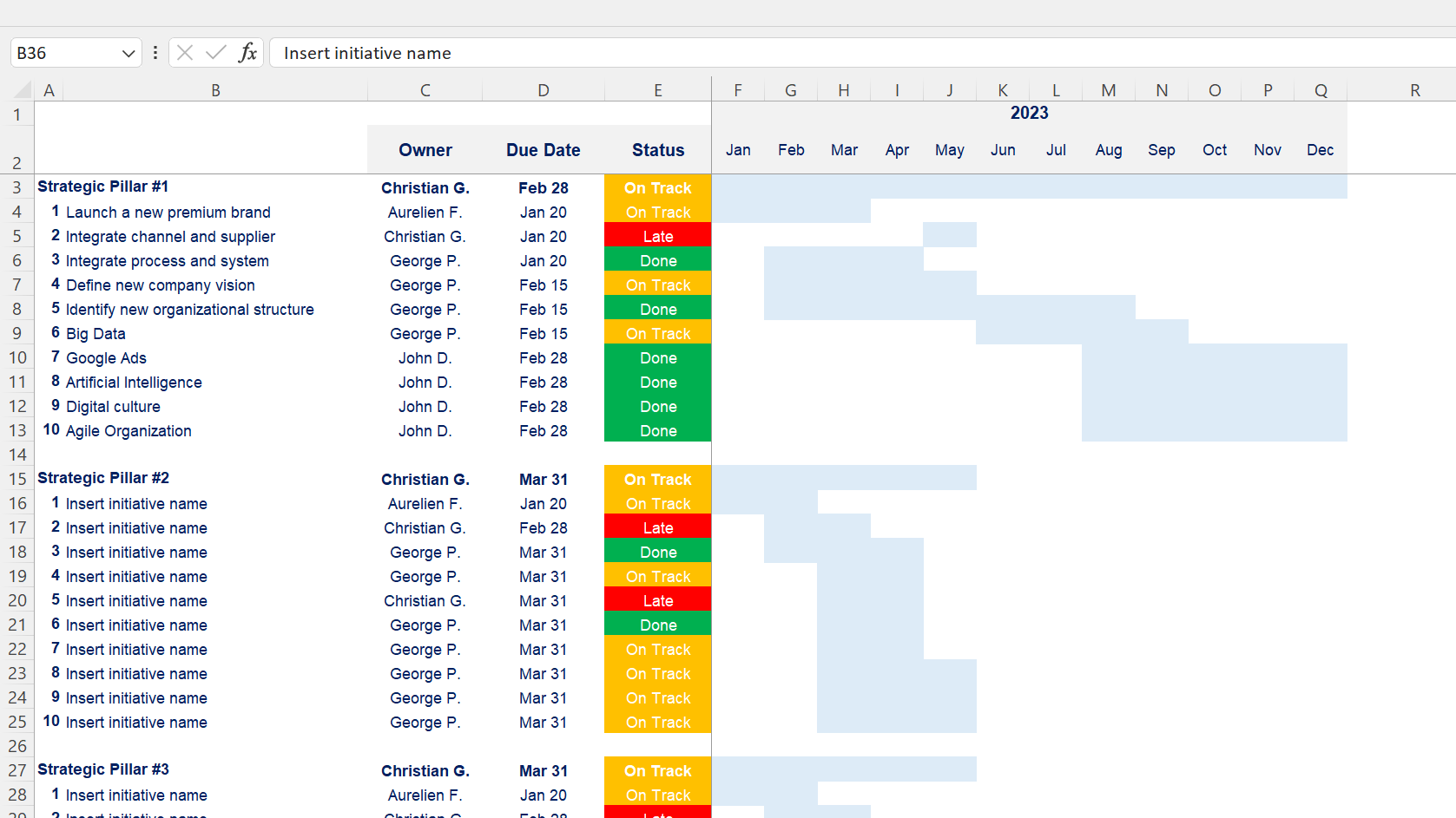

Slide 2

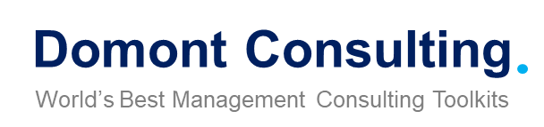
Corporate/Business Strategy and Strategic Planning Toolkit
Overview

Slide 3


Introduction
This Corporate/Business Strategy and Strategic Planning Toolkit was created by ex-McKinsey, Deloitte and BCG Strategy Consultants, after more than 6,000 hours of work. It is considered the world's best & most comprehensive Strategy Toolkit. It includes all the Frameworks, Best Practices and Templates required to define & implement a winning Corporate/Business Strategy and Strategic Plan for your organization.
Join the 200,000+ Executives, Consultants & Entrepreneurs who are already leveraging our Management Consulting Toolkits to improve the performance of their organization and boost their own career.
If you have any questions, send us an email at support@domontconsulting.com and one of our ex-McKinsey, Deloitte & BCG Management Consultants will get back to you within 2 business days.
Aurelien Domont
Management Consultant
Domont Consulting Managing Director

Slide 4
Problem: Most companies struggle to be good at both defining and executing their corporate/business strategy
Strategy/Execution matrix
Key takeaways
Companies that are in the green quadrant outperform their peers in terms of financial performance and total shareholder return.
But being good at both defining and executing a corporate/business strategy is challenging, with only a minority of companies able to do it.
As we often say in the corporate world, “Strategy without execution is a dream. And execution without a strategy is a nightmare!”
About 30% of companies have a good strategy but poor execution*
About 10% of companies have a good strategy and good execution*
Good
Strategy
About 30% of companies have a poor strategy and poor execution*
About 30% of companies have a poor strategy but good execution*
Poor
Poor
Good
Execution
Source: Based on the experience of our management consultants advising 200+ companies over the past 20 years

Slide 5












Solution: Our consulting firm created the Corporate/Business Strategy and Strategic Planning Toolkit to help you define and implement your strategy
What’s inside the Toolkit?
Who created the Toolkit?
The Toolkit was created by ex-McKinsey, Deloitte & BCG Strategy Consultants.
Best Practices
Frameworks
Number of professionals leveraging our Toolkits
Advice from
tier-1 Management Consultants
Tools
There are 200,000+ Executives, Consultants & Entrepreneurs leveraging our Toolkits to improve the performance of their organization
Real-life Examples
Templates
Trusted by small and large organizations
Video Training
Step-by-step Tutorials

Slide 6
Our Toolkit will help you fulfill multiple objectives
The Corporate/Business Strategy and Strategic Planning Toolkit includes frameworks, tools, templates, tutorials, real-life examples, video training, and best practices to help you:
Define and implement your corporate/business strategy and strategic plan with our 4-phase approach: (I) Internal and external analysis, (II) Strategy tools & frameworks to shape our strategy, (III) Strategy, (IV) Strategic plan, (V) Strategic dashboard
(I) Carry out an internal and external analysis: (1) Internal analysis: Financial analysis, HR analysis, Marketing analysis, Customers analysis, Suppliers analysis, (2) Market Analysis: Target market, Market sizing with TAM, Market attractiveness with Porter’s 5 Forces, Environment analysis with PESTLE, (3) Competitor Analysis: Competitor identification, Benchmarking, Strategic group mapping, Competitor profiling, (4) SWOT summary
(II) Shape your strategy with tools & frameworks commonly used by tier-one consulting firms: (1) Frameworks to answer strategic questions: What caused the profit to decrease?, Should we enter a new market?, Should we introduce a new product?, Should we acquire this company?, (2) BU/Product portfolio management tools: GE-McKinsey Matrix, BCG Growth-Share Matrix, (3) Corporate and growth strategy tools: 7 Degrees of Freedom for Growth, Ansoff Growth Matrix, Blue Ocean Strategy, McKinsey Seven-S, Porter’s Generic Corporate Strategies, Product Life Cycle, Greiner's Growth Model, (4) Other tools and framework: Value Chain Analysis, Value Driver Tree
(III) Define your strategy: (1) Business model, (2) Mission, vision and values, (3) Strategy map including the strategic objectives to reach our vision, (4) Balanced scorecard including the key performance indicators linked to the strategic objectives, (5) Strategic pillars to reach our strategic objectives, (6) Potential strategic initiatives in each strategic pillar, (7) Business cases and financial models to help us prioritize our list of potential strategic initiatives, (8) Project prioritization
(IV) Define and implement your strategic plan: (1) Guiding principles, (2) Strategic plan formulation: High-level strategic plan with the three horizons of growth , Detailed strategic plan, (3) Strategic plan implementation: Governance, Strategic objectives dashboard, Strategic pillars dashboard, Strategic initiatives dashboard, Objectives and key results (OKR), (4) Evaluation and lessons learnt
(V) Create strategic dashboards: (1) Annual, quarterly and monthly overall performance dashboards, (2) Revenue and profit actuals and estimates, (3) Sales and cost breakdown analysis, (4) Three financial statement model, (5) Other common charts

Slide 7

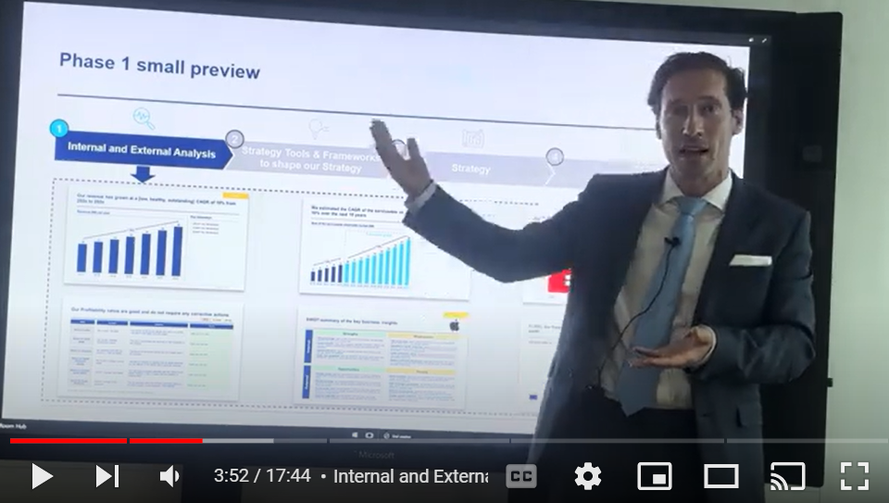
Video demonstration of the Corporate/Business Strategy and Strategic Planning Toolkit
Video Demo Access
Video Demo Visual
Select “Slide Show” mode and then click on the link below or on the image on the right to access this video demo.
You can also access the video by copy pasting the following URL in your browser:
https://youtu.be/fES_up2_BQE

Slide 8




The Toolkit includes a 4-phase approach that we have built and refined over the past 20 years through constant trial and error
1
2
3
4
Internal and External Analysis
Strategy Tools & Frameworks to shape our Strategy
Strategy
Strategic Plan
Internal analysis
Financial analysis
HR analysis
Marketing analysis
Customers analysis
Suppliers analysis
Market Analysis
Target market
Market sizing with TAM
Market attractiveness with Porter’s 5 Forces
Environment analysis with PESTLE
Competitor Analysis
Competitor identification
Benchmarking
Strategic group mapping
Competitor profiling
SWOT summary
Frameworks to answer strategic questions
What caused the profit to decrease?
Should we enter a new market?
Should we introduce a new product?
Should we acquire this company?
BU/Product portfolio management tools:
GE-McKinsey Matrix
BCG Growth-Share Matrix
Growth strategy tools
7 Degrees of Freedom for Growth
Ansoff Growth Matrix
Blue Ocean Strategy
McKinsey Seven-S
Porter’s Generic Corporate Strategies
Product Life Cycle
Greiner's Growth Model
Other tools & frameworks
Value chain analysis
Value Driver Tree
Pareto Principle
Etc.
Business model
Mission, vision and values
Strategy map including the strategic objectives to reach our vision
Balanced scorecard including the key performance indicators linked to the strategic objectives
Strategic pillars to reach our strategic objectives
Potential strategic initiatives in each strategic pillar
Business cases and financial models to prioritize our list of potential strategic initiatives
Project prioritization
Guiding principles
Strategic plan formulation
High-level strategic plan with the three horizons of growth
Detailed strategic plan
Strategic plan implementation
Governance
Strategic objectives dashboard
Strategic pillars dashboard
Strategic initiatives dashboard
Objectives and key results (OKR)
Evaluation and lessons learnt
Strategic Dashboards

Slide 9
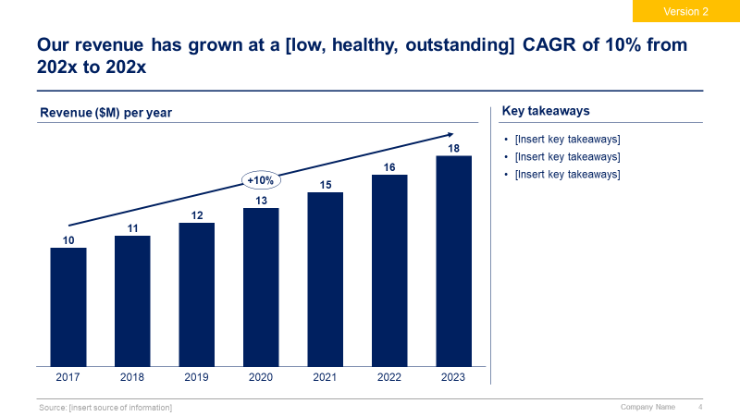
Phase 1 small preview
1
2
3
4
Internal and External Analysis
Strategy Tools & Frameworks to shape our Strategy
Strategy
Strategic Plan
Strategic Dashboards

Slide 10
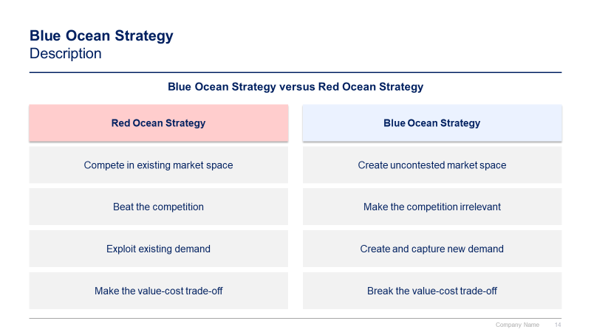
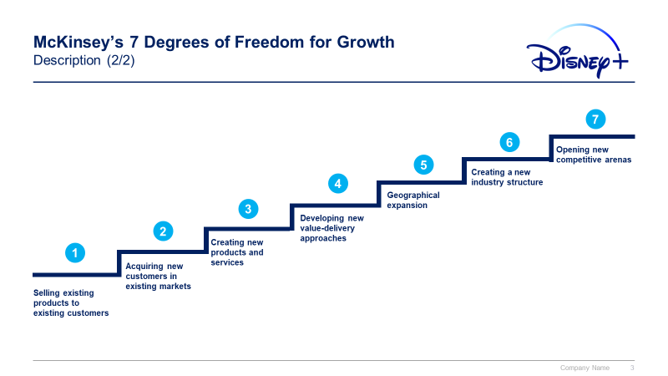
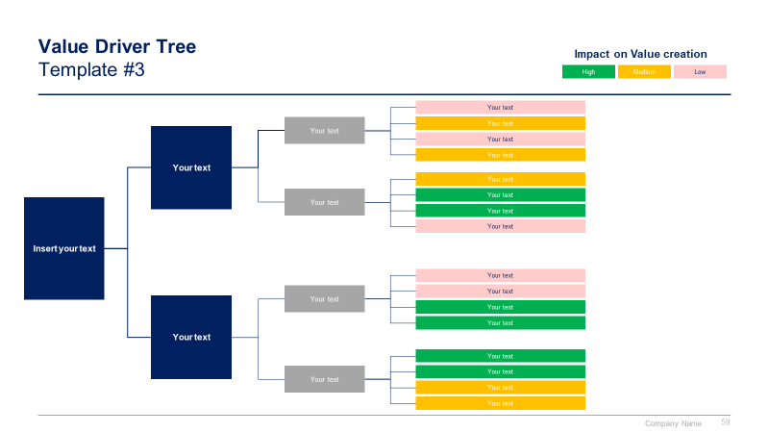
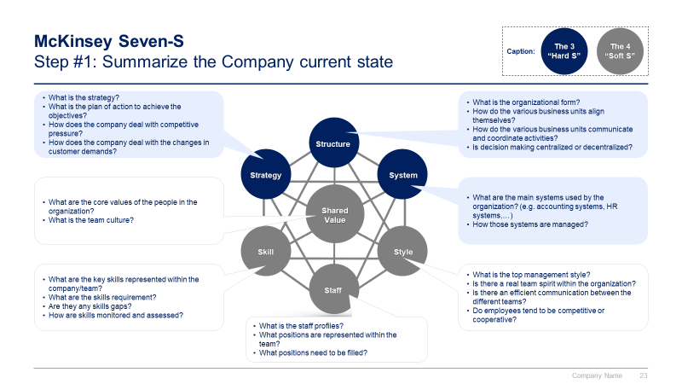
Phase 2 small preview
1
2
3
4
Internal and External Analysis
Strategy Tools & Frameworks to shape our Strategy
Strategy
Strategic Plan
Strategic Dashboards

Slide 11
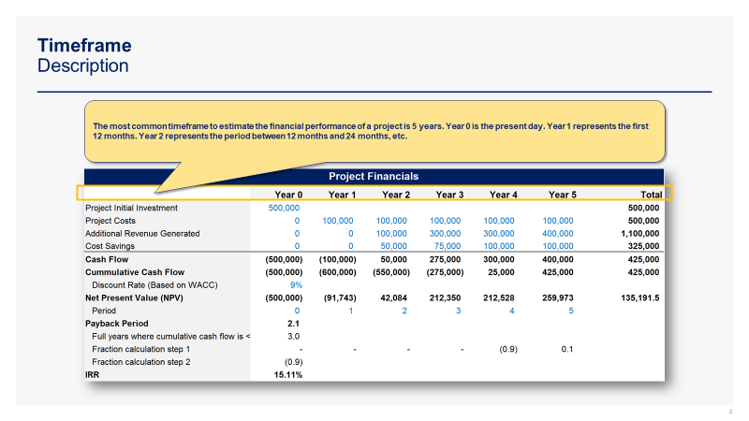
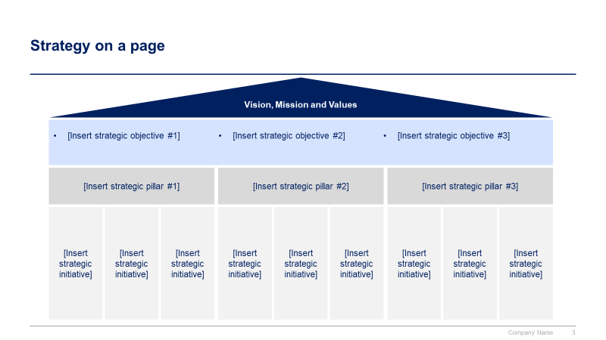
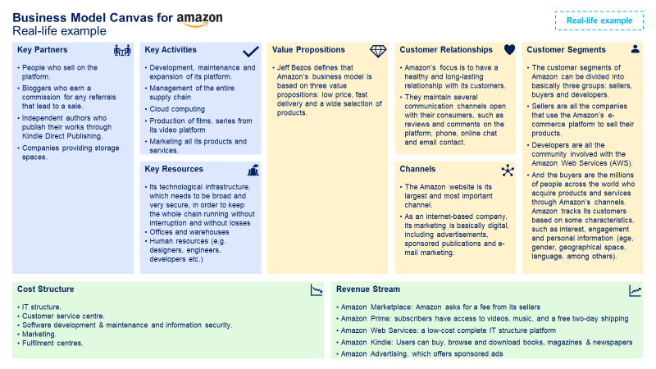
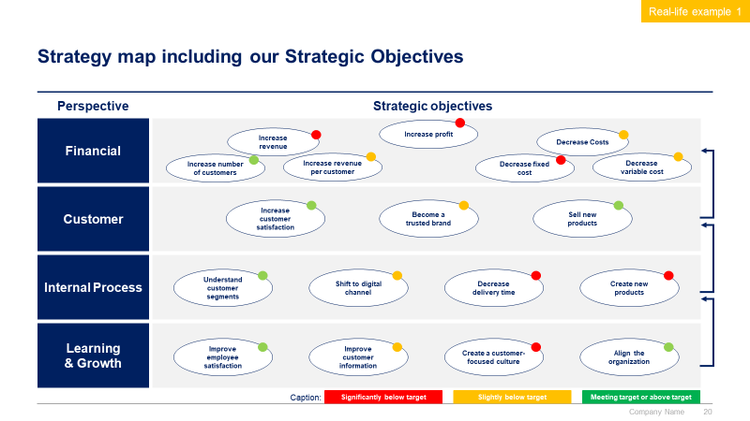
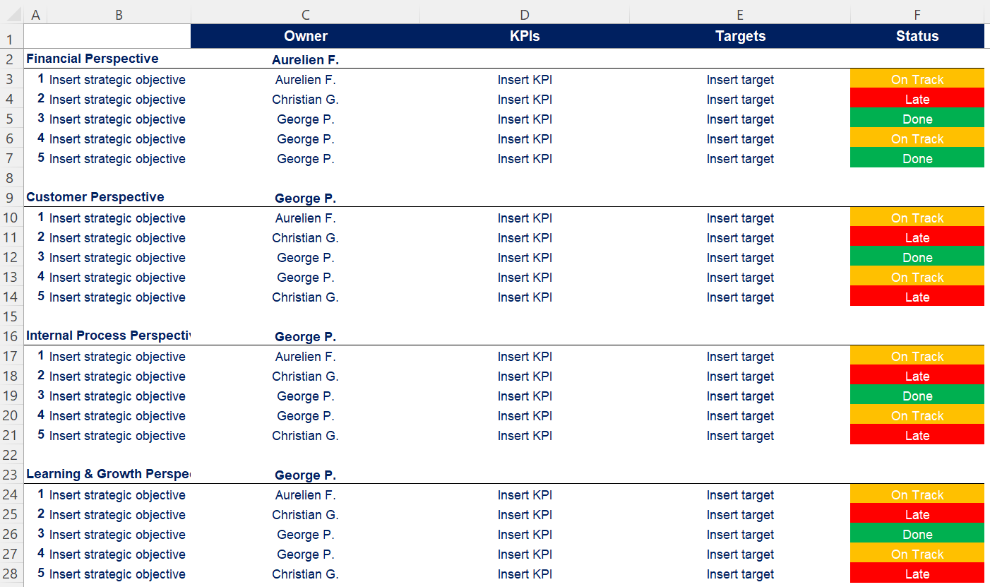
Phase 3 small preview
1
2
3
4
Internal and External Analysis
Strategy Tools & Frameworks to shape our Strategy
Strategy
Strategic Plan
Strategic Dashboards

Slide 12
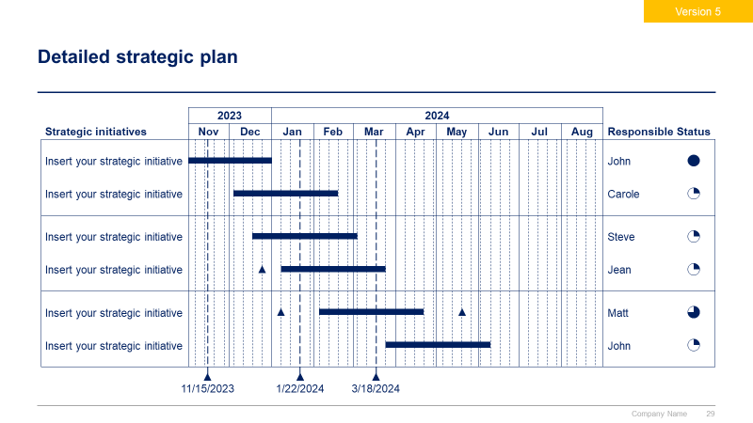
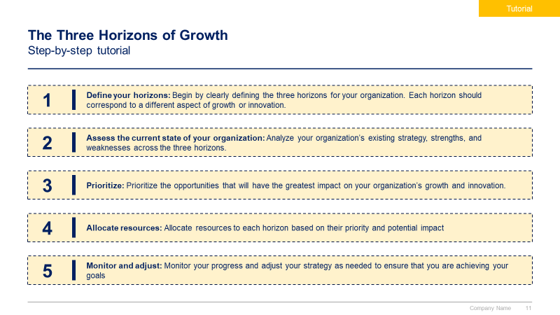
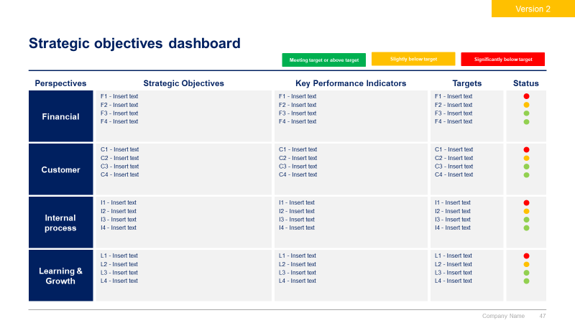
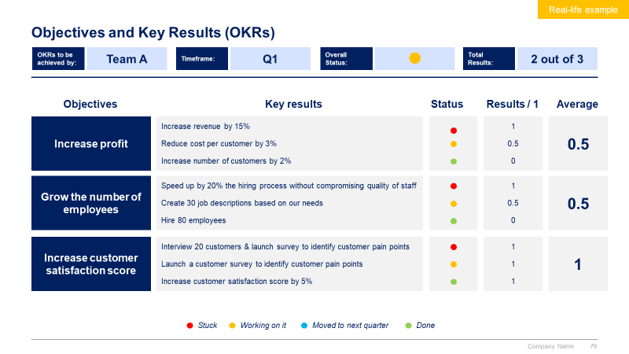
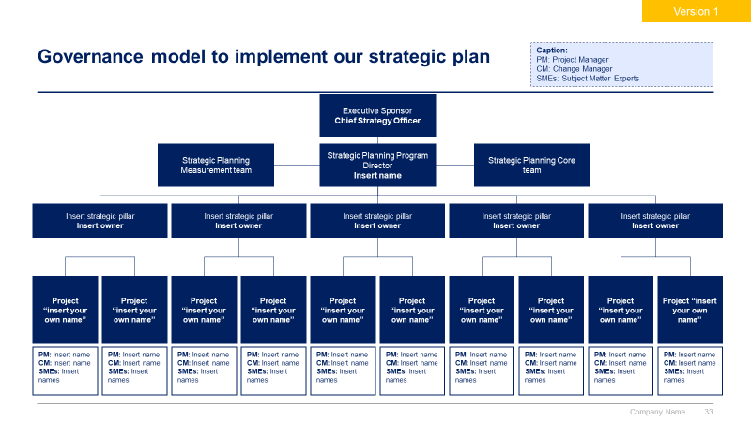
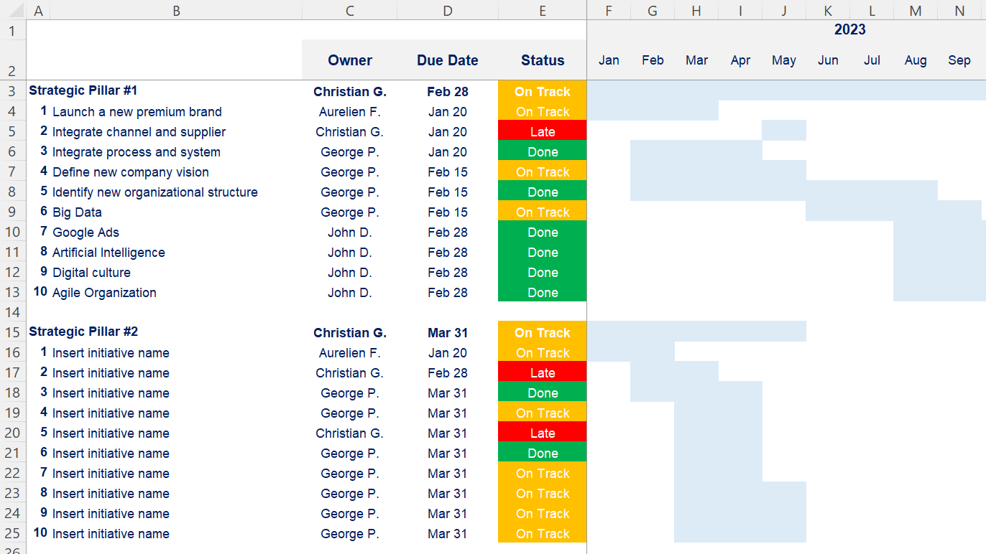
Phase 4 small preview
1
2
3
4
Internal and External Analysis
Strategy Tools & Frameworks to shape our Strategy
Strategy
Strategic Plan
Strategic Dashboards

Slide 13
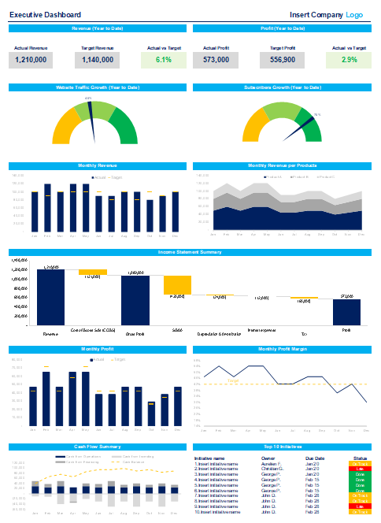
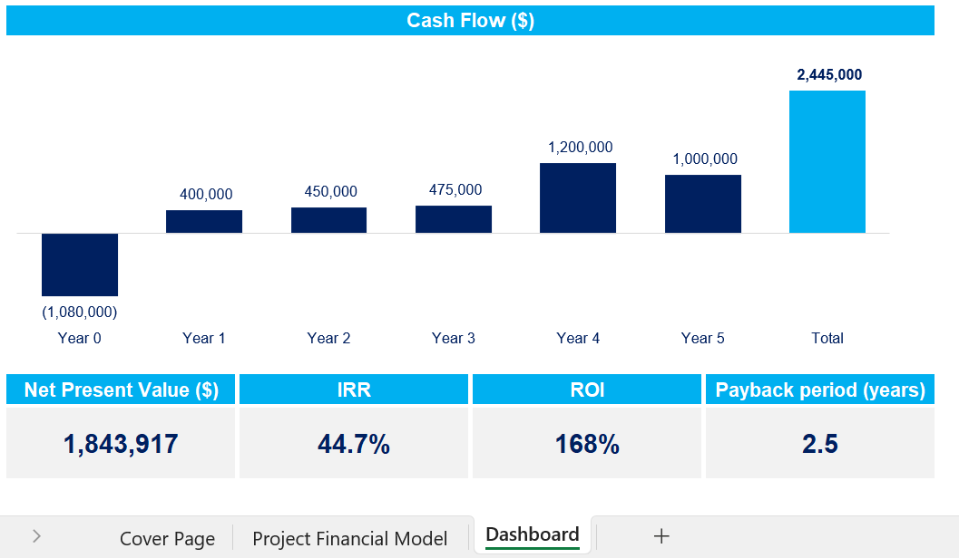
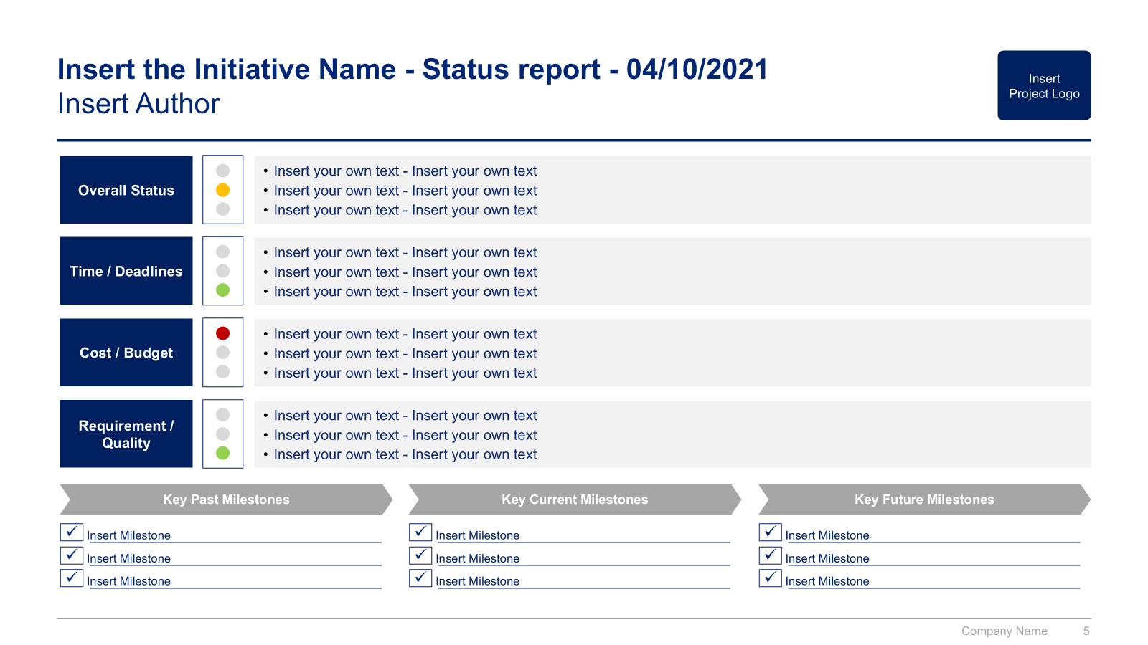
Transverse phase small preview
1
2
3
4
Internal and External Analysis
Strategy Tools & Frameworks to shape our Strategy
Strategy
Strategic Plan
Strategic Dashboards

Slide 14
In the next slides, you’ll see more content from the Corporate/Business Strategy and Strategic Planning Toolkit
1
2
3
4
Internal and External Analysis
Strategy Tools & Frameworks to shape our Strategy
Strategy
Strategic Plan
Internal analysis
Financial analysis
HR analysis
Marketing analysis
Customers analysis
Suppliers analysis
Market Analysis
Target market
Market sizing with TAM
Market attractiveness with Porter’s 5 Forces
Environment analysis with PESTLE
Competitor Analysis
Competitor identification
Benchmarking
Strategic group mapping
Competitor profiling
SWOT summary
Frameworks to answer strategic questions
What caused the profit to decrease?
Should we enter a new market?
Should we introduce a new product?
Should we acquire this company?
BU/Product portfolio management tools:
GE-McKinsey Matrix
BCG Growth-Share Matrix
Growth strategy tools
7 Degrees of Freedom for Growth
Ansoff Growth Matrix
Blue Ocean Strategy
McKinsey Seven-S
Porter’s Generic Corporate Strategies
Product Life Cycle
Greiner's Growth Model
Other tools & frameworks
Value chain analysis
Value Driver Tree
Pareto Principle
Etc.
Business model
Mission, vision and values
Strategy map including the strategic objectives to reach our vision
Balanced scorecard including the key performance indicators linked to the strategic objectives
Strategic pillars to reach our strategic objectives
Potential strategic initiatives in each strategic pillar
Business cases and financial models to prioritize our list of potential strategic initiatives
Project prioritization
Guiding principles
Strategic plan formulation
High-level strategic plan with the three horizons of growth
Detailed strategic plan
Strategic plan implementation
Governance
Strategic objectives dashboard
Strategic pillars dashboard
Strategic initiatives dashboard
Objectives and key results (OKR)
Evaluation and lessons learnt
Strategic Dashboards

Slide 15




Our balanced scorecard highlights a strong [insert your own adjective] performance in most of our 12 strategic objectives
Version 3
Meeting target
Slightly below target
Below target
Perspective
Strategic Objectives
Key Performance Indicators
Last Year
Target
This Year
Financial
F1: Increase earnings per share
F2: Increase revenue
F3: Increase profit margin
F1: Net income per share (vs. last year)
F2: Revenue growth vs previous year
F3: Profit margin
F1: +$100M
F2: 10%
F3: 18%
F1: +$100M
F2: 12%
F3: 19%
F1: +$100M
F2: 11%
F3: 20%
Customer
C1: Increase customer satisfaction
C2: Increase revenue per customer
C3: Reduce cost per customer
C1: Net promoter score
C2: Revenue per customer
C3: Cost per customer
C1: 50%
C2: $300
C3: $75
C1: 55%
C2: $320
C3: $70
C1: 60%
C2: $315
C3: $76
Internal Process
I1: Decrease number of defects
I2: Increase revenue per employee
I3: Increase project success rate
I1: % of products with a defect
I2: Revenue per employee
I3: Project success rate
I1: 0.52%
I2: $250k
I3: 60%
I1: 0.42%
I2: $275k
I3: 70%
I1: 0.42%
I2: $270k
I3: 71%
Learning & Growth
L1: Increase employer satisfaction
L2: Enhance employee skills
L3: Develop a mentorship Program
L1: Employee net promoter score
L2: % of employees completing courses
L3: Number of mentor-mentee pairs
L1: 60%
L2: 62%
L3: 200
L1: 70%
L2: 63%
L3: 300
I1: 72%
I2: 64%
I3: 250
Source: Company’s [insert name] software

Slide 16
The profit across all BUs has been increasing over the past 5 years [insert your own text]
BU 1 Profit ($M)
BU 2 Profit ($M)
BU 3 Profit ($M)
BU 4 Profit ($M)

Slide 17
We decided to use the BCG matrix to help us better understand our current BU [if needed, replace BU by product] portfolio (1/2)
The BCG Growth-Share Matrix, also known as the Boston Consulting Group Matrix, is a portfolio management tool that helps companies decide how to prioritize their different businesses. The matrix is split into four quadrants, each with its own unique symbol that represents a certain degree of profitability: question marks, stars, pets (often represented by a dog), and cash cows. By assigning each business to one of these four categories, executives could then decide where to focus their resources and capital to generate the most value, as well as where to cut their losses.
The matrix was created in 1968 by Bruce Henderson, the founder of BCG. It was built on the logic that market leadership results in sustainable superior returns. Ultimately, the market leader obtains a self-reinforcing cost advantage that competitors find difficult to replicate. These high growth rates then signal which markets have the most growth potential.
Each of the four quadrants represents a specific combination of relative market share and market growth rate:
Low Growth, High Share: Companies should milk these “cash cows” for cash to reinvest.
High Growth, High Share: Companies should significantly invest in these “stars” as they have high future potential.
High Growth, Low Share: Companies should invest in or discard these “question marks,” depending on their chances of becoming stars.
Low Share, Low Growth: Companies should liquidate, divest, or reposition these “pets.”
The matrix reveals two factors that companies should consider when deciding where to invest: company competitiveness and market attractiveness, with relative market share and growth rate as the underlying drivers of these factors.
The BCG Growth-Share Matrix is still central in business school teachings on business strategy and has been used by about half of all Fortune 500 companies.

Slide 18



We decided to use the BCG matrix to help us better understand our current BU [if needed, replace BU by product] portfolio (2/2)
No Investment
More investment
Caption:
High
Question mark
Description: High growth but neutral or negative cash flow (expensive growth)
Strategy: See if ROI can be improved
Star
Description: Growing earnings, positive or neutral cash flow
Strategy: Invest in growth
Growth rate
Dog
Description: Small market share in low growth market, requires much capital to continue
Strategy: Divest or close
Cash cow
Description: Stable earnings and solid cash flow, low growth business
Strategy: Milk for remaining value
Low
Low
Market share
High

Slide 19
Our BU [insert BU or Product] portfolio is currently balanced [insert your own description]
Version 1 - Automated chart
Growth rate (201x-202x)
Size = Annual revenue ($M) in 202x
BU2
BU1
BU3
BU4
BU6
BU5
Market share (202x)

Slide 20
Our BU [insert BU or Product] portfolio is currently balanced [insert your own description]
Version 2 - Manual chart
No Investment
More investment
Caption:
High
Question mark
Star
Product A
Product B
Product C
Growth rate
Dog
Cash cow
Product G
Product D
Product H
Product E
Product F
Low
Low
Market share
High

Slide 21
In 202x, the Product B was the main contributor to our total revenue and profit
Revenue ($M), 202x
Profit ($M), 202x
Product A
Product C
Product D
Product B
Total
Product A
Product C
Product D
Product B
Total
Source: [insert source of information]

Slide 22



The Toolkit includes multiple PowerPoint slides, Excel sheets and Video training that you can download on your device immediately after purchase
600 editable PowerPoint slides*
50 Excel sheets*
70 minutes of Video training
Overview and Approach
Internal and External Analysis
Strategy Tools & Frameworks to shape our Strategy
Strategy
Strategic Plan
Strategic Dashboards
*Please note that the number of PowerPoint slides and Excel sheets listed is the number of unique slides and sheets. For example, a PowerPoint slide that has been duplicated to facilitate our clients’ understanding only counts for one slide

Slide 23









Our Management Consulting Toolkits include 9 key benefits
Improve the growth & efficiency of your organization by leveraging Management Consulting Toolkits created by ex-McKinsey, Deloitte & BCG Consultants.
Make a great investment for your career & organization. It cost us US$8M+ over the past 10 years to create all our Toolkits. Get them for a fraction of this cost.
Get a competitive advantage. It’s like hiring Management Consultants to create all the practical Frameworks, Tools & Templates you need.
Get the job done quicker and never start from scratch again with our ready-made and fully editable Frameworks, Tools & Templates in PowerPoint & Excel.
Don't reinvent the wheel. We have already worked 30,000+ hours over the past 10 years to create all the Management Consulting Toolkits you need.
Improve the capabilities of your organization by learning how the Fortune 100 and Global Consulting Firms do it.
Decrease your costs. Hiring tier-1 Consultants for a project would cost you $300k+. Way more expensive than our Toolkits, which will last you a lifetime!
Become your organization’s subject matter expert and impress your stakeholders with world-class approaches to resolve common business problems.
Get free support and advice from our ex-McKinsey, Deloitte & BCG Management Consultants.

Slide 24
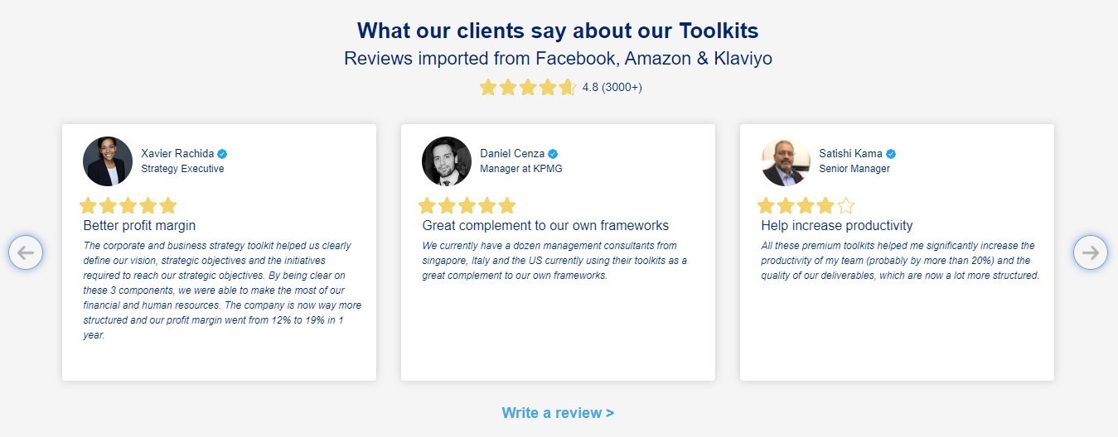
What our clients say about our Toolkits
Click here to see more reviews >

Slide 25

Join 200,000+ Executives, Consultants & Entrepreneurs leveraging our Toolkits to improve the performance of their organization
Trusted by small and large organizations
Customer satisfaction
4.8
Number of countries leveraging our Toolkits
160+
Number of professionals leveraging our Toolkits
200,000+
Daily rate of our ex-McKinsey, Deloitte and BCG Management Consultants
$3k-$4k

Slide 26

Interested in more than 1 Toolkit? Access all our Toolkits for half the price with our Gold Access
Gold Access
Click here to learn more

Slide 27


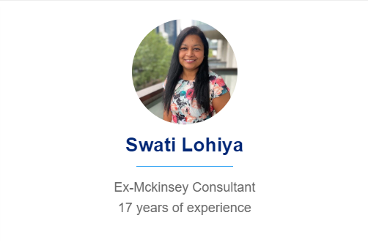

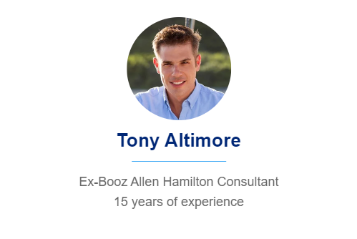

Need additional help? Send us a brief and we’ll find you the right talent from our network of 500+ tier-1 Management Consultants
Click here to send us a Project Brief

Slide 28
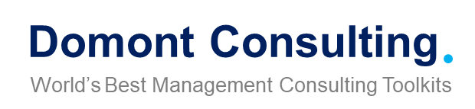
This was just a small preview.
www.domontconsulting.com

